Slide 1
Rape Crime Statistics: A Comparative study Among three nations
MANJIMA RIT Enrolment No – 2212209001006 Registration No – 220010044170
UG SEMESTER – VI, DEPARTMENT OF STATISTICS,
SISTER NIVEDITA UNIVERSITY

Slide 2
CONTENTS
ABSTRACT
INTRODUCTION
OBJCTIVES
METHODOLOGY
STUDY AREA
CONCLUSION
LIMITATIONS
REFERENCES

Slide 3
ABSTRACT
Aims: This project aims to fit time series model and forecast the rape crime rates against women of three diverse countries namely India, Germany and Kenya and within, India its top 10 states and union territories which leads the rape crime rate.
The project begins with collecting of historical reported rape crime rates from national crime websites and international reports.
Fundamental analysis techniques: Quality of the data has been checked, presence of missing-values and outliers are taken into concern. Graphs and heatmaps has been used for clear and easy data analysis.
Forecasting analysis: For time series analysis Arima model and R-programming are used.

Slide 4
INTRODUCTION
General Legal Defination of Rape: Rape is the act of engaging in sexual intercourse or other forms of sexual penetration with another person without their consent, typically through force, threats, manipulation or when the person is incapable of giving consent due to age, mental incapacity, or intoxication.
This project focuses on analyzing historical rape crime rate data for past 19 years (2004 to 2022) for three countries Germany (a European country) which is considered to be a developed country in economic field. Secondly, Kenya (an African country) which is considered to be a lower- or middle-income country in economic field. Thirdly, India (an Asian country) which is considered to be a developing or lower- or middle-income country in economic field and most importantly it’s our nationality.
Further the project explores on the Indian states and union territories which leads the top 10’s list in rape crime rate all over India then analyse and predict their forecasted values for next 10 years (2023-2032).

Slide 5
OBJECTIVE
To Forecast Rape Cases for the Next 10 Years (2023–2032): With the use of ARIMA models, we will fit models to the respected nations and states. Then forecast the number of rape cases in each of the (TOP 10) states as the prediction of long-term trends helps to assess whether the situation is likely to improve or worsen without significant intervention.
Data Visualisation causes for public awareness: Through interactive visualizations and accessible analysis, the project can educate the public about the ongoing and projected state of women's safety on a world-wide basis.
To Analyze Historical Trends of Rape Cases: Seeking to examine the global trend year-wise of total cases for 3 countries (India, Germany and Kenya). Identifying patterns, fluctuations and significant spikes or drops in reported cases for these countries. Within India, the objective is to examine the year-wise data on reported rape cases of the TOP 10 Indian states and union territories.
To Identify State-wise Hotspots of Gender-based Violence: The project helps to highlight the regions with consistently high or increasing numbers of rape cases and compares the state performances based on normalized crime rates (cases per lakh population) which helps to understand socio-demographic factors contributing to regional disparities.

Slide 6
METHODOLOGY
Datasets
Dataset for India, Germany and Kenya.
Dataset for top 10 Indian states and union territories.
Data Analysis through Graphical Representations.
Quality checking of the data.
Time Series Forecasting Using Arima models.
Comparison of the three countries based on their predicted values.
Comparison and Prediction of the rank of Top 10 states in India.

Slide 7
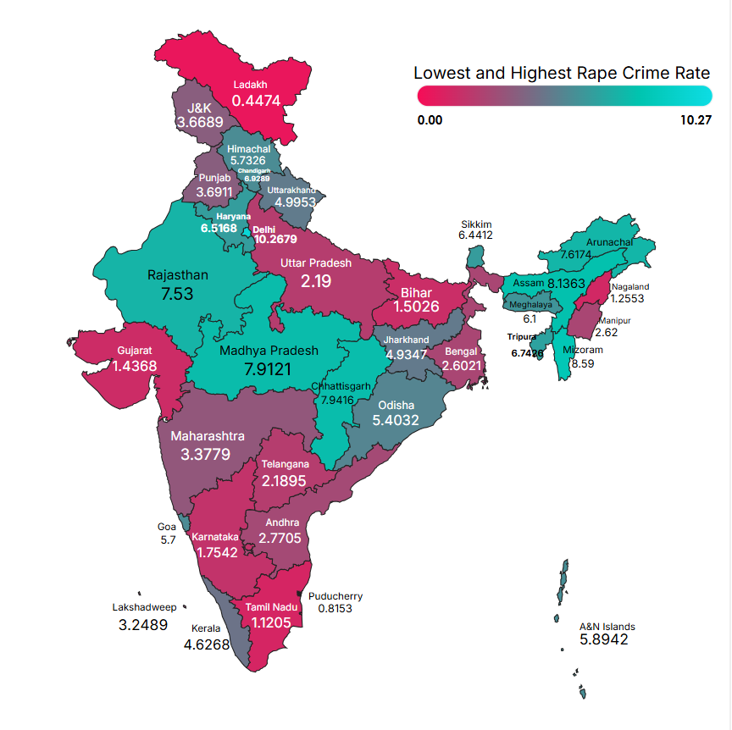
HEAT MAP OF INDIA
Heatmap for India showing the states and union territories with highest and lowest rape crime rate,2004-2022.

Slide 8
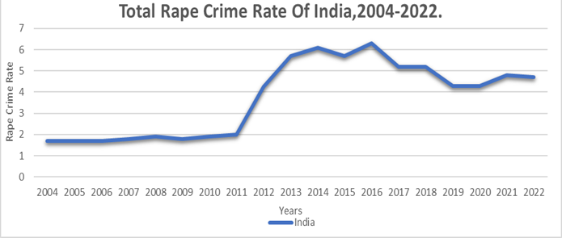
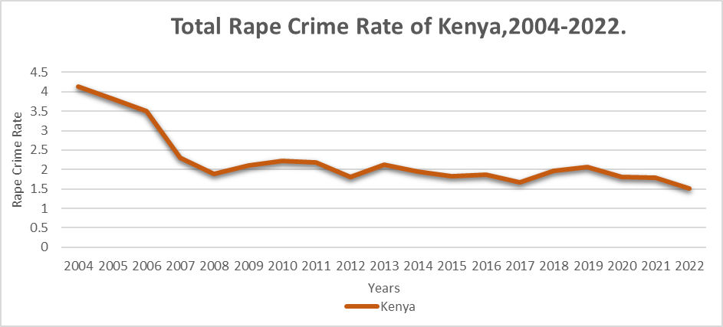
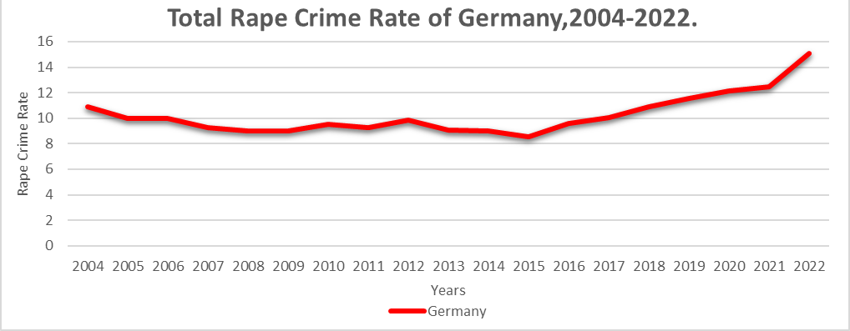
GRAPHICAL ANALYSIS
The graphical representation of India, Germany and Kenya
Fig-1
Fig-3
Rape cases in India started to increase from the year 2012 with highest reported cases in the year 2016 (i.e.,6.3).
For Kenya in the previous years cases seem to be increased but gradually decreased over the years with short-term fluctuations. Highest rape cases in Kenya was seen in the year 2004 (i.e., 4.14).
Fig-2
In Germany, rape cases has an overall increased number. Highest reported rape cases were seen in the year 2021 (i.e., 12.48)

Slide 9
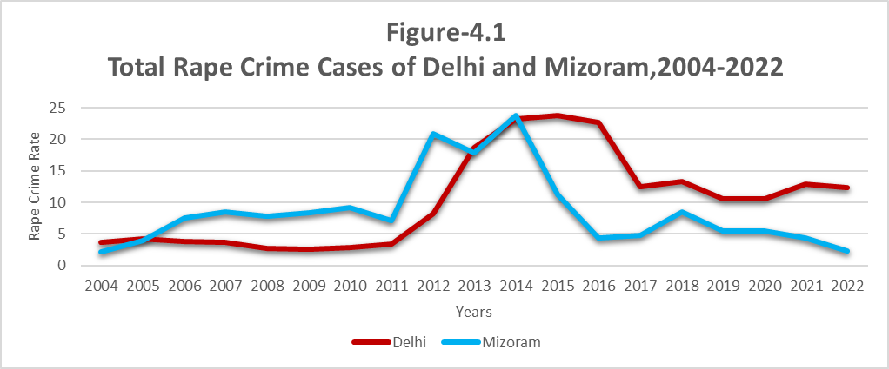
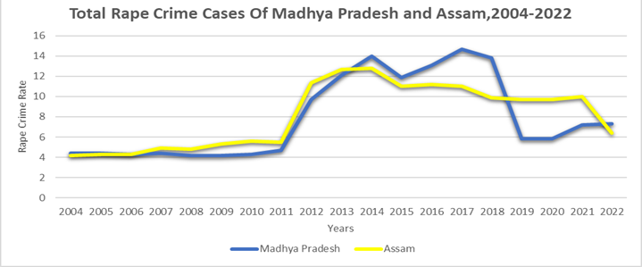
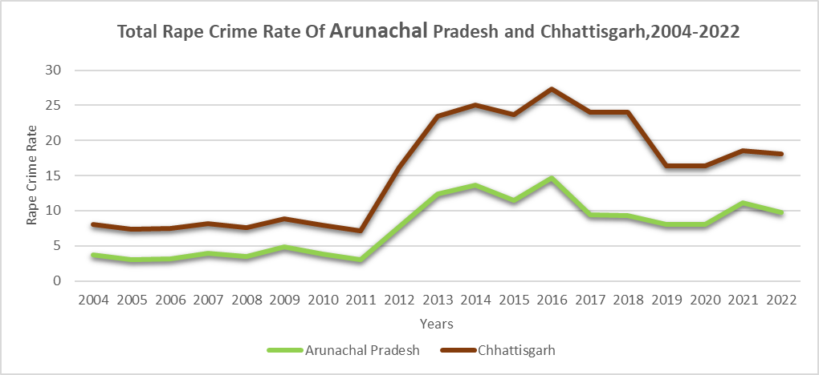
GRAPHICAL ANALYSIS
The graphical representation of top 10 states in India (Delhi, Mizoram, Madhya Pradesh, Arunachal Pradesh and Chhattisgarh
Fig-4
Fig-5
In Delhi, the cases started growing immensely from 2012 with highest reported cases in the year 2015. (i.e., 23.7) and for Mizoram in the year 2012 (i.e., 20.81)
Since the beginning Mizoram has a high reported rape cases but seems decreased in the later years.
Both Madhya Pradesh and Assam had lower rape cases in the initial years and started to increase since 2012.
Madhya Pradesh saw its highest number of cases in they year 2017(i.e., 14.7) and for Assam in 2014 (i.e., 12.8)
Fig-6
Both Arunachal Pradesh and Chhattisgarh has short-term fluctuations in their number of reported rape cases. Rape cases started to rise from 2012.
Arunachal Pradesh has highest reported cases in the year 2016 (i.e., 14.7) and Chhattisgarh in the year 2018 (i.e., 14.7).

Slide 10
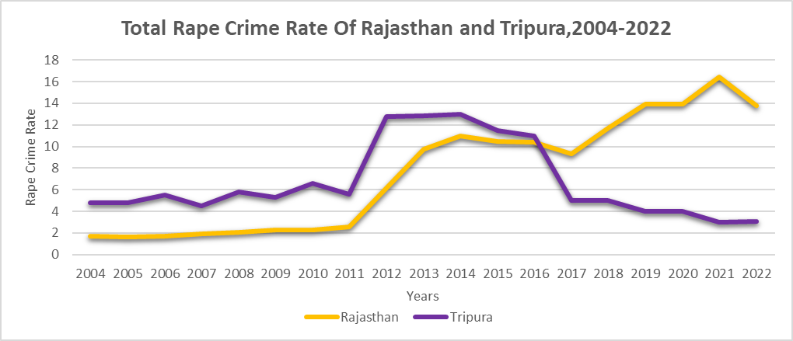
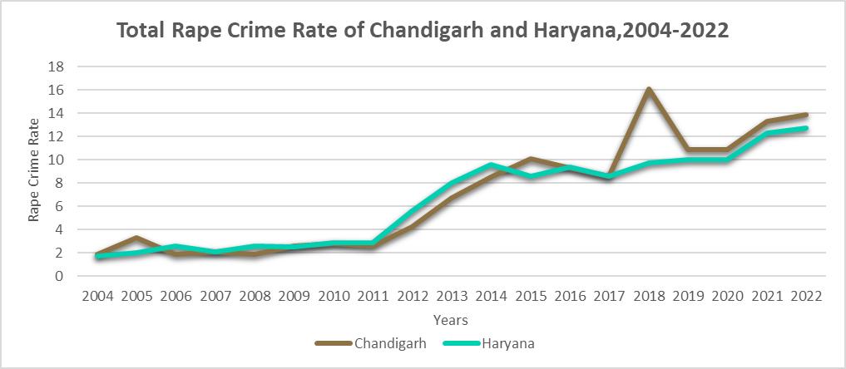
GRAPHICAL ANALYSIS
The graphical representation of top 10 states in India (Rajasthan, Tripura, Chandigarh and Haryana)
Fig- 7
In the initial years, Rajasthan has low rape cases whereas Tripura has high cases and short-term fluctuations in the data.
Highest cases for Rajasthan was reported in 2021 (i.e., 16.4) and for Tripura it was 2013 (i.e., 12.84).
Fig- 8
In 2005 Chandigarh, had a rise in the number of cases. Later highest reported cases were seen in the year 2018 (i.e., 16.1).
Haryana has short-term fluctuations in it’s reported cases with highest number of cases in the year 2022 (i.e., 12.7).

Slide 11
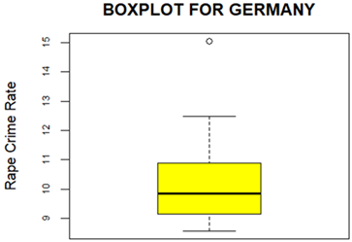
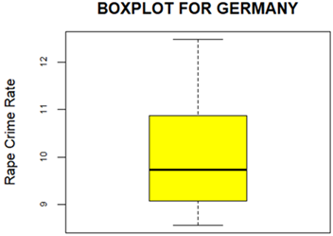
QUALITY OF THE DATA Outliers checking through boxplot for Germany
Fig- 9
Fig- 10
Here the dataset of Germany has one outlier. So to carry out the time series analysis we choose to remove the outlier, causing a significant 5% data loss.

Slide 12
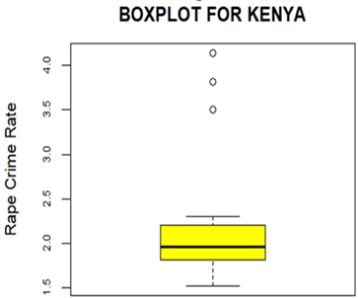
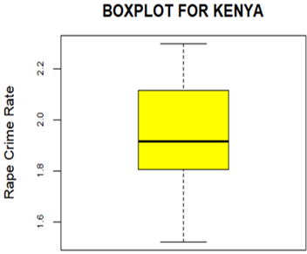
QUALITY OF THE DATA Outliers checking through boxplot for Kenya
Fig- 11
Fig- 12
Here the dataset of Kenya three outliers. So to carry out the time series analysis we choose to remove the outliers, causing a significant 15% data loss.

Slide 13
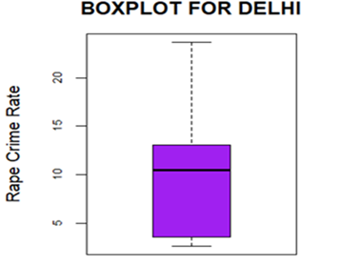
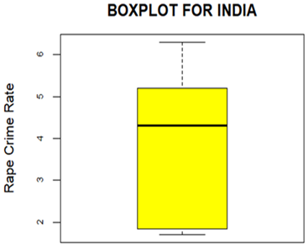
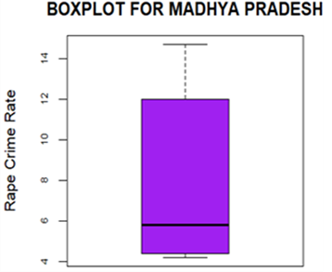
QUALITY OF THE DATA Outliers checking through boxplot for India and two of its states (Delhi and Madhya Pradesh)
Fig- 13
Fig- 14
Fig- 15
From the above Box & Whiskers plots, the dataset of Delhi, India, Madhya Pradesh has no outliers.

Slide 14
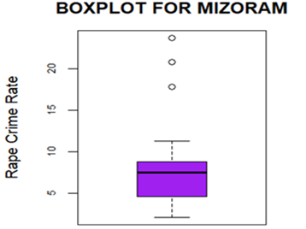
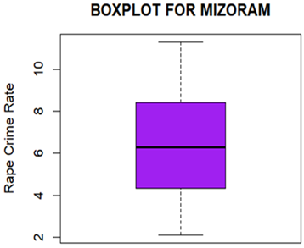
QUALITY OF THE DATA Outliers checking through boxplot for Mizoram
Fig- 16
Fig-17
Here the dataset of Mizoram has three outlier. So to carry out the time series analysis we choose to remove the outlier, causing a significant 15% data loss.

Slide 15
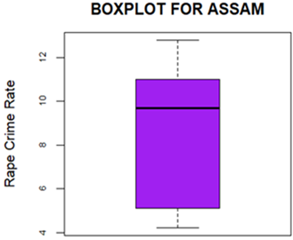
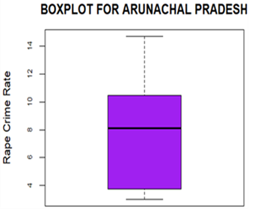
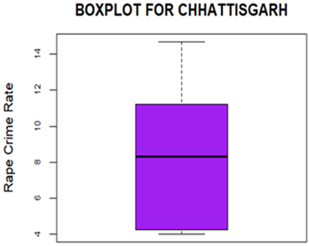
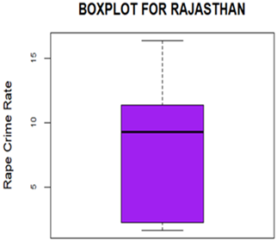
QUALITY OF THE DATA Outliers checking through boxplot Assam, Arunachal Pradesh, Chhattisgarh and Rajasthan
Fig- 21
Fig- 20
Fig- 19
Fig- 18
From the above Box & Whiskers plots, the dataset of Assam, Arunachal Pradesh, Chhattisgarh, Rajasthan no outliers.

Slide 16
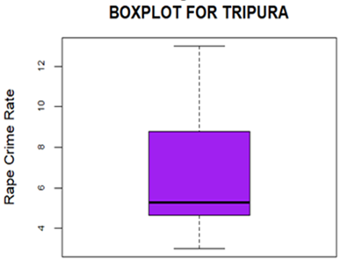
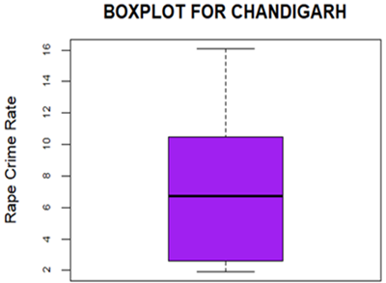
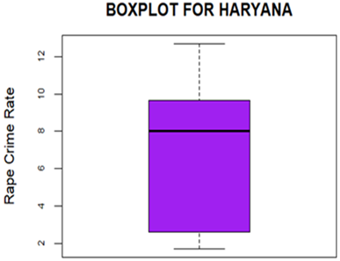
QUALITY OF THE DATA Outliers checking through boxplot for Tripura, Chandigarh and Haryana
Fig- 22
Fig- 23
Fig- 24
From the above Box & Whiskers plots, the dataset of Tripura, Chandigarh and Haryana has no outliers.

Slide 17
ARIMA MODEL
Auto Regressive Integrated Moving Average (ARIMA) is a popular time series forecasting model that combines three key components:
AR (p): Autoregressive part which uses past values to predict the current value.
I (d): Integrated part which differences the data d times to make it stationary.
MA (q): Moving Average part which uses past forecast errors to predict the current value.

Slide 18
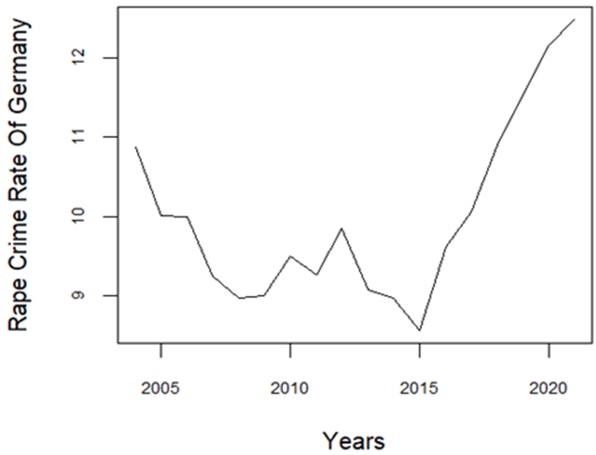
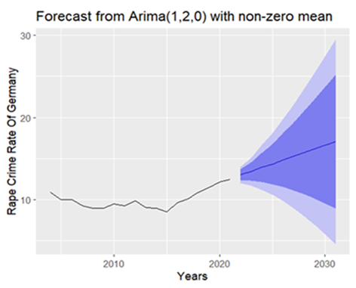
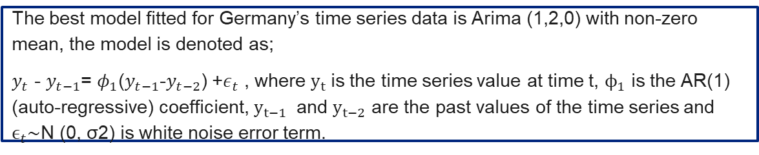
TIME SERIES ANALYSIS AND MODEL FITTING Model fitting to Germany’s dataset with the help of Arima model
Fig- 25
Fig- 26
The best model fitted for Germany’s time series data is Arima (1,2,0) with non-zero mean, the model is denoted as;
$y_{t}$ - $y_{t−1}$= $φ_{1}$($y_{t−1}$-$y_{t−2}$) +$ε_{t}$ , where ​$y_{t}$is the time series value at time t, $ϕ_{1}$ is the AR(1) (auto-regressive) coefficient, $y_{t−1}$ and $y_{t−2}$ are the past values of the time series and $ϵ_{t}$∼N (0, σ2) is white noise error term.

Slide 19
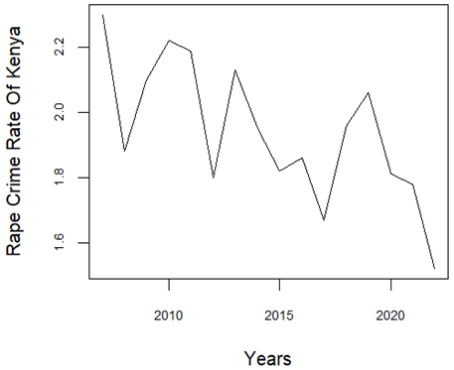
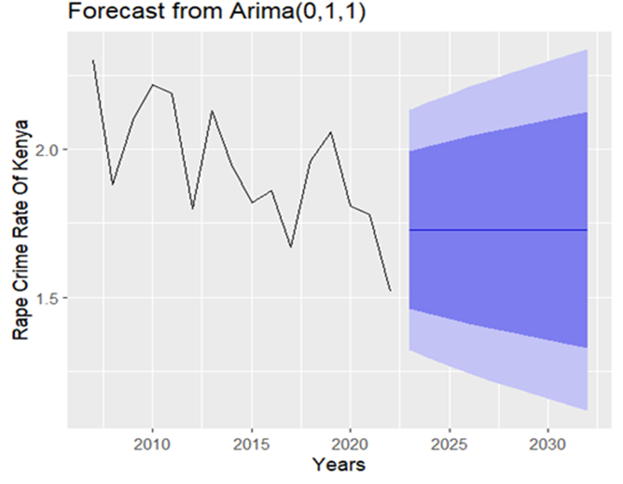
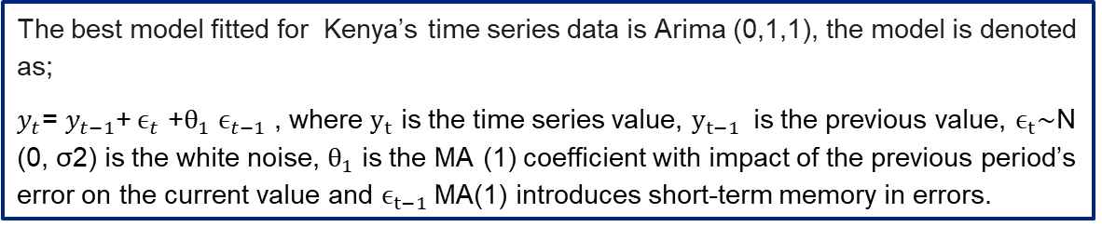
TIME SERIES ANALYSIS AND MODEL FITTING Model fitting to Kenya’s dataset with the help of Arima model
Fig- 26
Fig- 27
The best model fitted for Kenya’s time series data is Arima (0,1,1), the model is denoted as;
$y_{t}$= $y_{t−1}$​+$ϵ_{t}$ ​+$θ_{1}$ $ϵ_{t−1}$ , where $y_{t}$ is the time series value, $y_{t−1}$ is the previous value, $ϵ_{t}$∼N (0, σ2) is the white noise, $θ_{1}$ is the MA (1) coefficient with impact of the previous period’s error on the current value and $ϵ_{t−1}$MA(1) introduces short-term memory in errors.

Slide 20
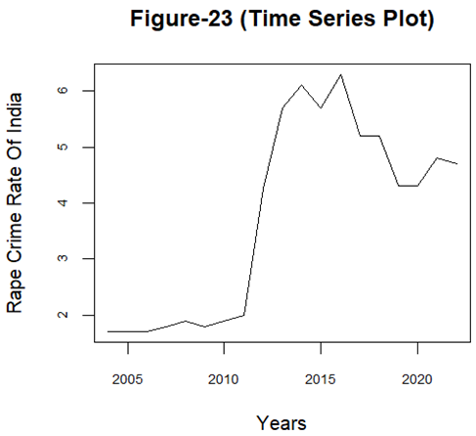
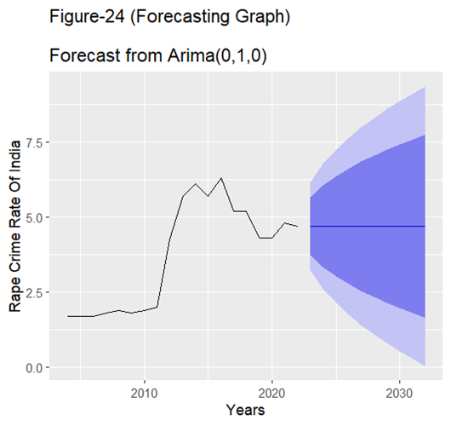
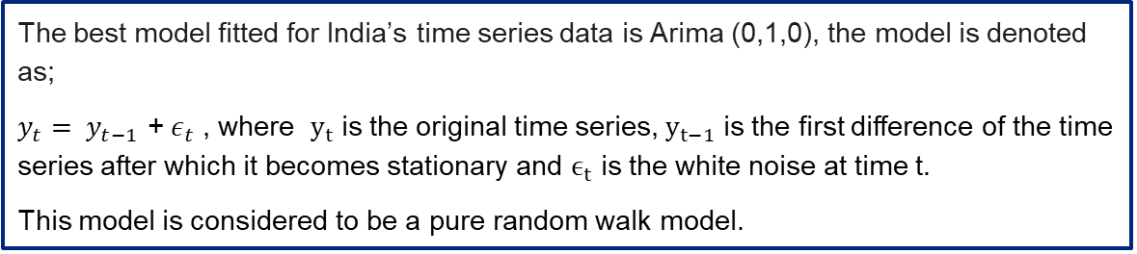
TIME SERIES ANALYSIS AND MODEL FITTING Model fitting to India’s dataset with the help of Arima model
Fig- 28
Fig- 29
The best model fitted for India’s time series data is Arima (0,1,0), the model is denoted as;
$y_{t}= y_{t−1}$ + $ε_{t}$ , where $y_{t}$ is the original time series, $y_{t−1}$ is the first difference of the time series after which it becomes stationary and $ϵ_{t}$ is the white noise at time t.
This model is considered to be a pure random walk model.

Slide 21
COMPARISON Comparison based on the forecasted values among India, Germany and Kenya based obtained from the fitted models for the next upcoming 10 years (2023-2032).
Fig- 30
Based on the forecasted values by using best fitted Arima models for each, we predict that for the upcoming 10 years (2023-2032) the forecasted rape crime rate:
India and Kenya shows a stabilized trend.
Germany shows an upward trend.
For forecasted table click here FORECAST TABLE

Slide 22
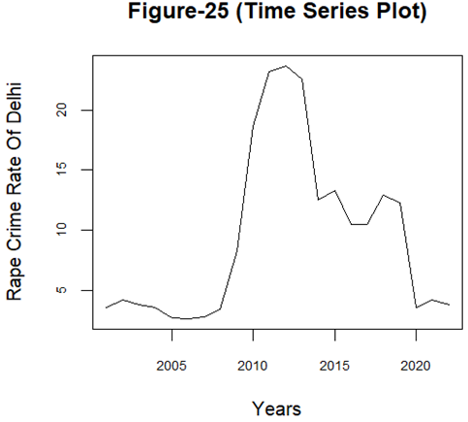
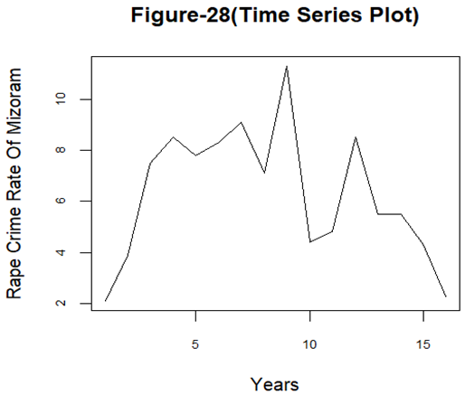
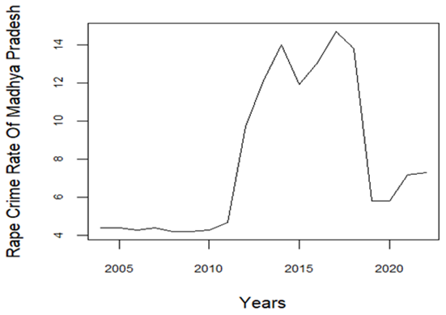
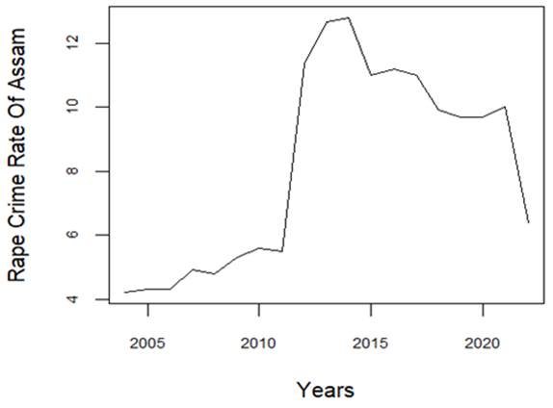
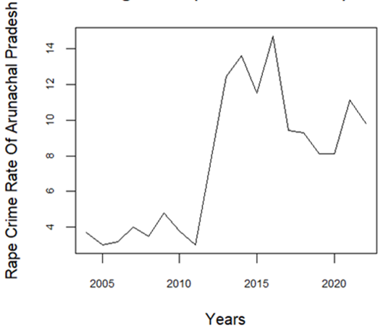
TOP 10 STATES TIME SERIES ANALYSIS Time series plot of Delhi, Mizoram, Madhya Pradesh, Assam and Arunachal Pradesh
Fig- 31
Fig- 32
Fig- 33
Fig- 34
Fig- 35

Slide 23
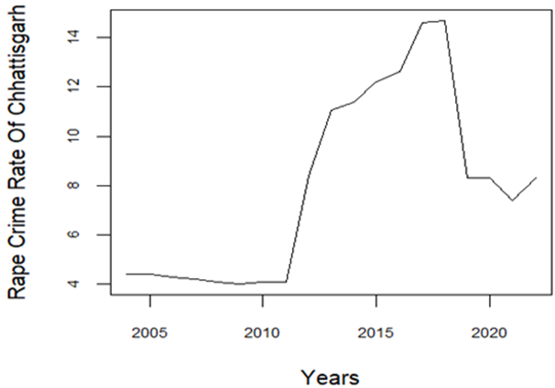
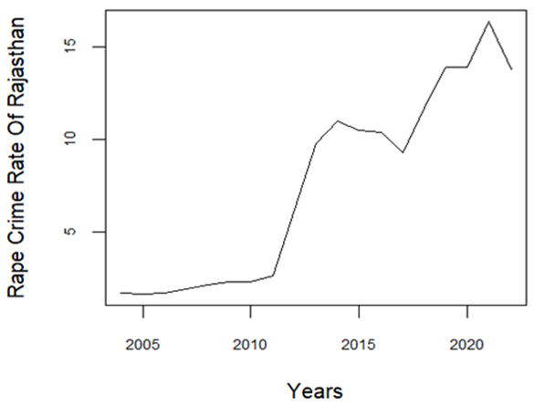
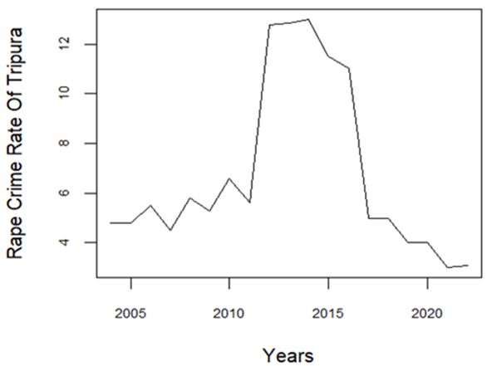
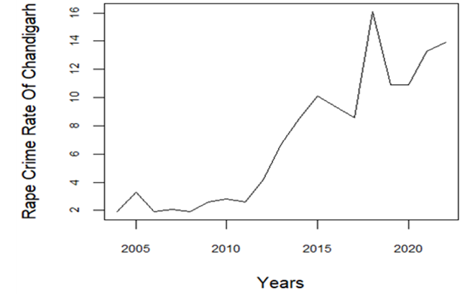
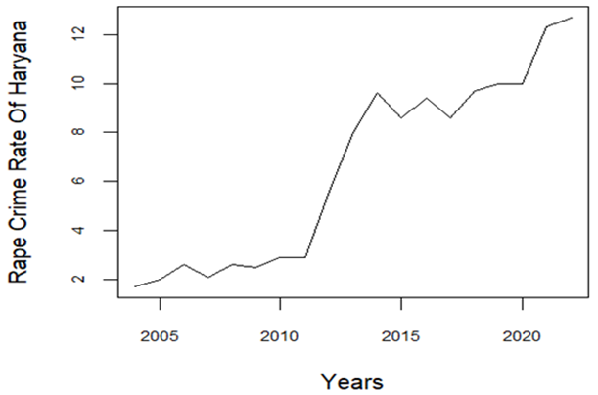
TOP 10 STATES TIME SERIES ANALYSIS Time series plot of Chhattisgarh, Rajasthan, Tripura, Chandigarh and Haryana.
Fig- 36
Fig- 37
Fig- 38
Fig- 39
Fig- 40

Slide 24
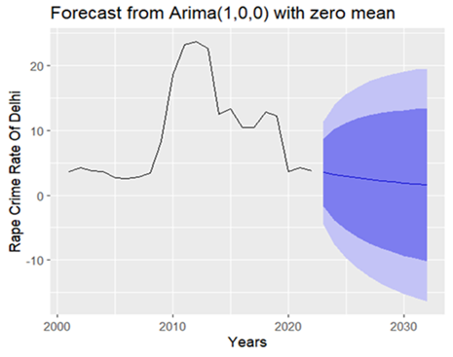
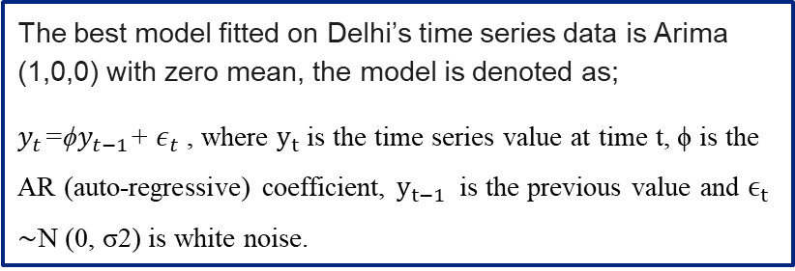
TIME SERIES ANALYSIS AND MODEL FITTING Model fitting to Delhi’s dataset with the help of Arima model
Fig- 41
The best model fitted on Delhi’s time series data is Arima (1,0,0) with zero mean, the model is denoted as;
$y_{t}$=ϕ$y_{t−1}$+ $ε_{t}$ , where $y_{t}$is the time series value at time t, ϕ is the AR (auto-regressive) coefficient, $y_{t−1}$ is the previous value and $ϵ_{t}$ ∼N (0, σ2) is white noise.

Slide 25
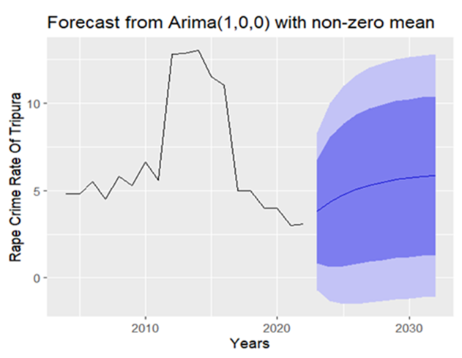
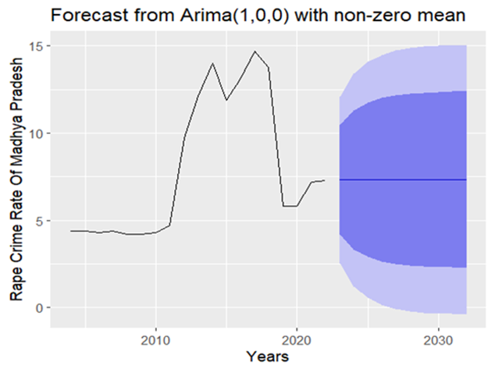
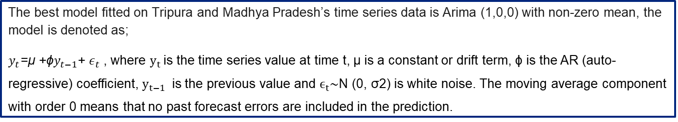
TIME SERIES ANALYSIS AND MODEL FITTING Model fitting to Tripura and Madhya Pradesh’s dataset with the help of Arima model
Fig- 42
Fig- 43
The best model fitted on Tripura and Madhya Pradesh’s time series data is Arima (1,0,0) with non-zero mean, the model is denoted as;
$y_{t}$=μ +ϕ$y_{t−1}$+ $ε_{t}$ , where $y_{t}$is the time series value at time t, μ is a constant or drift term, ϕ is the AR (auto-regressive) coefficient, $y_{t−1}$ is the previous value and $ϵ_{t}$∼N (0, σ2) is white noise. The moving average component with order 0 means that no past forecast errors are included in the prediction.

Slide 26
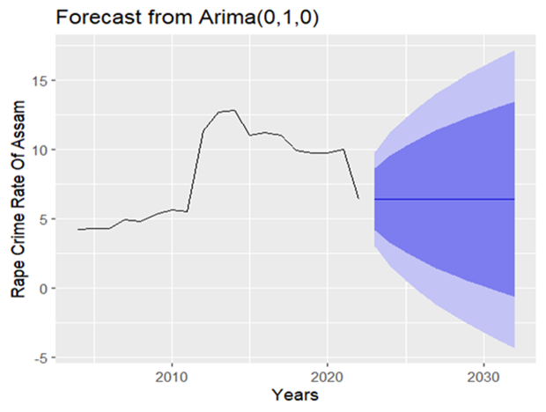



TIME SERIES ANALYSIS AND MODEL FITTING Model fitting to Assam, Arunachal Pradesh and Chhattisgarh’s dataset with the help of Arima model
Fig- 44
Fig- 45
Fig- 46
The best model fitted on Assam, Arunachal Pradesh and Chhattisgarh’s time series data is Arima (0,1,0) the model is denoted as;
$y_{t}= y_{t−1}$ + $ε_{t}$ , where $y_{t}$ is the original time series, $y_{t−1}$ is the first difference of the time series after which it becomes stationary and $ϵ_{t}$ is the white noise at time t.

Slide 27



TIME SERIES ANALYSIS AND MODEL FITTING Model fitting to Rajasthan and Haryana’s dataset with the help of Arima model
Fig- 47
For the states Rajasthan and Haryana, the best fitted model for the given time series data for each of these states is Arima(0,1,0) with drift and is denoted by:
$y_{t}= y_{t−1}$+µ+ $ε_{t}$ , where $y_{t}$ is the original time series, $y_{t−1}$ is the first difference of the time series after which it becomes stationary and $ϵ_{t}$ is the white noise at time t.
Fig- 48

Slide 28




TIME SERIES ANALYSIS AND MODEL FITTING Model fitting to Rajasthan and Haryana’s dataset with the help of Arima model
Fig- 49
The best model fitted on Mizoram’s time series data is Arima (0,0,0) with non-zero mean and the model is denoted as;
$y_{t}$=μ+ $ε_{t}$ , where $y_{t}$is the time series value at time t, μ is constant mean (non-zero as specified) and $ϵ_{t}$ is random white noise.
Fig- 50
The best model fitted on Chandigarh’s time series data is Arima (0,1,1) with drift and the model is denoted as;
$y_{t}$= $y_{t−1}$​+ μ+$ϵ_{t}$ ​+$θ_{1}$ $ϵ_{t−1}$ , where $y_{t}$ is the time series value, $y_{t−1}$ is the previous value, μ is constant or drift term, $ϵ_{t}$∼N (0, σ2) is the white noise, $θ_{1}$ is the MA (1) coefficient with impact of the previous period’s error on the current value and $ϵ_{t−1}$MA(1) introduces short-term memory in errors.

Slide 29
PREDICTIVE RANKING
Comparing and ranking the past top 10 states in India based on their forecasted values for upcoming 10 years
Line diagram representing the top 10 states in India for the next upcoming 10 years (2023-2032).
To view the comparison table click here

Slide 30
CONCLUSION
Living in the 21st century and through statistical analysis we observe that a heinous crime like rape still prevails against women in the society globally.
We observe that a developed country like Germany might see an increase in rape crime rate in the nearest future.
Under developed countries like India and Kenya saw a stable growth for the upcoming years.
Within, India based on the forecasted values for Delhi and Mizoram we observe high decline in the rape crime rate for the upcoming next ten years.
In case of Chandigarh, Rajasthan and Haryana we observe high increase in the rape crime rate for the upcoming next ten years.
Addressing rape requires a united global and national effort through education, stronger law enforcement, survivor support, and cultural change to ensure safety, justice and dignity for all.

Slide 31
LIMITATIONS
Data Availability and Reliability: This study is heavily dependent on secondary data from government and international sources. In many countries, underreporting of rape cases due to stigma, fear, or lack of legal support affects the reliability of available statistics.
Differences in Legal Definitions: The definition of rape and sexual assault varies significantly across different countries and jurisdictions.
Sample Size: In this project sample size was a problem as to be a perfect fit for Arima model we minimum require a sample size of 50-100.
Being a B.sc student my knowledge was limited, also because of time and resource constraints, only basic comparative techniques, time series model and graphical representations were used, rather than more sophisticated model approaches.

Slide 32
REFERENCES
Rape crime rate for Germany and Kenya for the years 2004-2003 was taken from https://dataunodc.un.org/dp-crime-violent-offences
Rape crime rate for and Indian states the years 2004-2003 was taken from https://www.ncrb.gov.in/crime-in-india-table-content.html
Fundamentals of Statistics (Vol II) - A.K. Gun, M.K Gupta, B Dasgupta.
An Outline of Statistical Analysis Theory (Voll II) - A.K. Gun, M.K Gupta, B Dasgupta.
Introduction to Time Series Analysis and Forecasting- Douglas C. Montgomery, Chery L. Jennings, Murat Kulach.

Slide 33
THANK YOU

Slide 34
ORIGINAL DATASET FOR INDIA,GERMANY AND KENYA
Years | Rape Crime Rate of India
2004 | 1.7
2005 | 1.7
2006 | 1.7
2007 | 1.8
2008 | 1.9
2009 | 1.8
2010 | 1.9
2011 | 2
2012 | 4.26
2013 | 5.69
2014 | 6.1
2015 | 5.7
2016 | 6.3
2017 | 5.2
2018 | 5.2
2019 | 4.3
2020 | 4.3
2021 | 4.8
2022 | 4.7
Years | Rape Crime Rate of Germany
2004 | 10.87
2005 | 10.01
2006 | 10
2007 | 9.25
2008 | 8.98
2009 | 9
2010 | 9.5
2011 | 9.26
2012 | 9.85
2013 | 9.07
2014 | 8.97
2015 | 8.56
2016 | 9.62
2017 | 10.06
2018 | 10.9
2019 | 11.52
2020 | 12.15
2021 | 12.48
2022 | 15.06
Years | Rape Crime Rate of Kenya
2004 | 4.14
2005 | 3.81
2006 | 3.5
2007 | 2.3
2008 | 1.88
2009 | 2.1
2010 | 2.22
2011 | 2.19
2012 | 1.8
2013 | 2.13
2014 | 1.95
2015 | 1.82
2016 | 1.86
2017 | 1.67
2018 | 1.96
2019 | 2.06
2020 | 1.81
2021 | 1.78
2022 | 1.52
Back

Slide 35
ORIGINAL DATASET FOR TOP 10 INDIAN STATES AND UNION TERRITORIES
Years | Delhi | Mizoram | Madhya Pradesh | Assam | Arunachal Pradesh | Chhattisgarh | Rajasthan | Tripura | Chandigarh | Haryana
2004 | 3.6 | 2.1 | 4.4 | 4.2 | 3.7 | 4.4 | 1.7 | 4.8 | 1.9 | 1.7
2005 | 4.2 | 3.9 | 4.4 | 4.3 | 3 | 4.4 | 1.6 | 4.8 | 3.3 | 2
2006 | 3.8 | 7.5 | 4.3 | 4.3 | 3.2 | 4.3 | 1.7 | 5.5 | 1.9 | 2.6
2007 | 3.6 | 8.5 | 4.4 | 4.9 | 4 | 4.2 | 1.9 | 4.5 | 2.1 | 2.1
2008 | 2.7 | 7.8 | 4.2 | 4.8 | 3.5 | 4.1 | 2.1 | 5.8 | 1.9 | 2.6
2009 | 2.6 | 8.3 | 4.2 | 5.3 | 4.8 | 4 | 2.3 | 5.3 | 2.6 | 2.5
2010 | 2.8 | 9.1 | 4.3 | 5.6 | 3.8 | 4.1 | 2.3 | 6.6 | 2.8 | 2.9
2011 | 3.4 | 7.1 | 4.7 | 5.5 | 3 | 4.1 | 2.6 | 5.6 | 2.6 | 2.9
2012 | 8.26 | 20.81 | 9.72 | 11.34 | 7.71 | 8.41 | 6.19 | 12.77 | 4.21 | 5.6
2013 | 18.63 | 17.8 | 12.11 | 12.65 | 12.42 | 11.08 | 9.78 | 12.84 | 6.74 | 8.02
2014 | 23.2 | 23.7 | 14 | 12.8 | 13.6 | 11.4 | 11 | 13 | 8.5 | 9.6
2015 | 23.7 | 11.3 | 11.9 | 11 | 11.5 | 12.2 | 10.5 | 11.5 | 10.1 | 8.6
2016 | 22.6 | 4.4 | 13.1 | 11.2 | 14.7 | 12.6 | 10.4 | 11 | 9.3 | 9.4
2017 | 12.5 | 4.8 | 14.7 | 11 | 9.4 | 14.6 | 9.3 | 5 | 8.6 | 8.6
2018 | 13.3 | 8.5 | 13.8 | 9.9 | 9.3 | 14.7 | 11.7 | 5 | 16.1 | 9.7
2019 | 10.5 | 5.5 | 5.8 | 9.7 | 8.1 | 8.3 | 13.9 | 4 | 10.9 | 10
2020 | 10.5 | 5.5 | 5.8 | 9.7 | 8.1 | 8.3 | 13.9 | 4 | 10.9 | 10
2021 | 12.9 | 4.3 | 7.2 | 10 | 11.1 | 7.4 | 16.4 | 3 | 13.3 | 12.3
2022 | 12.3 | 2.3 | 7.3 | 6.4 | 9.8 | 8.3 | 13.8 | 3.1 | 13.9 | 12.7
Back

Slide 36
TABLE FOR FORECASTED VALUE
Table representing the forecasted values for the three countries Germany, Kenya and India.
 | Germany |  |  | Kenya |  | India
Year |  | Forecasted rape crime rate | Year | Forecasted rape crime rate | Year | Forecasted rape crime rate
2023 |  | 13.41399 | 2023 | 1.727274 | 2023 | 4.7
2024 |  | 13.91169 | 2024 | 1.727274 | 2024 | 4.7
2025 |  | 14.33503 | 2025 | 1.727274 | 2025 | 4.7
2026 |  | 14.81084 | 2026 | 1.727274 | 2026 | 4.7
2027 |  | 15.24963 | 2027 | 1.727274 | 2027 | 4.7
2028 |  | 15.71454 | 2028 | 1.727274 | 2028 | 4.7
2029 |  | 16.16102 | 2029 | 1.727274 | 2029 | 4.7
2030 |  | 16.62050 | 2030 | 1.727274 | 2030 | 4.7
2031 |  | 17.07081 | 2031 | 1.727274 | 2031 | 4.7
2032 |  | 17.52760 | 2032 | 1.727274 | 2032 | 4.7
Analysis based on the forecasted values:
Forecasted rape crime cases in Germany increases every one year after.
Forecasted rape crime case for India and Kenya gives constant value and shows stabilized growth.
Back

Slide 37
PREDICTIVE RANK TABLE OF 10 INDIAN STATES
From the above table we can conclude that:
Chandigarh with in the past years (2004-2022) was the top 9th state in rape crime rate becomes the leading state in rape crime rate.
Also, the state which lead the top 10’s list in the past 19 years seems to be the last among all the top 10 states.
Back

